Slide 1

Disk SUM IOPS Detector on SAP VM brownbag
SAP Enablement Team

Slide 2
Agenda
Context
Analysis
Kusto Query

Slide 3
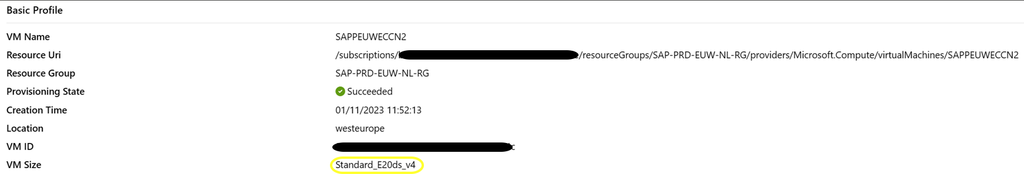
SR: 2306210030004689
Context: Customer has requested some advisory questions

Slide 4
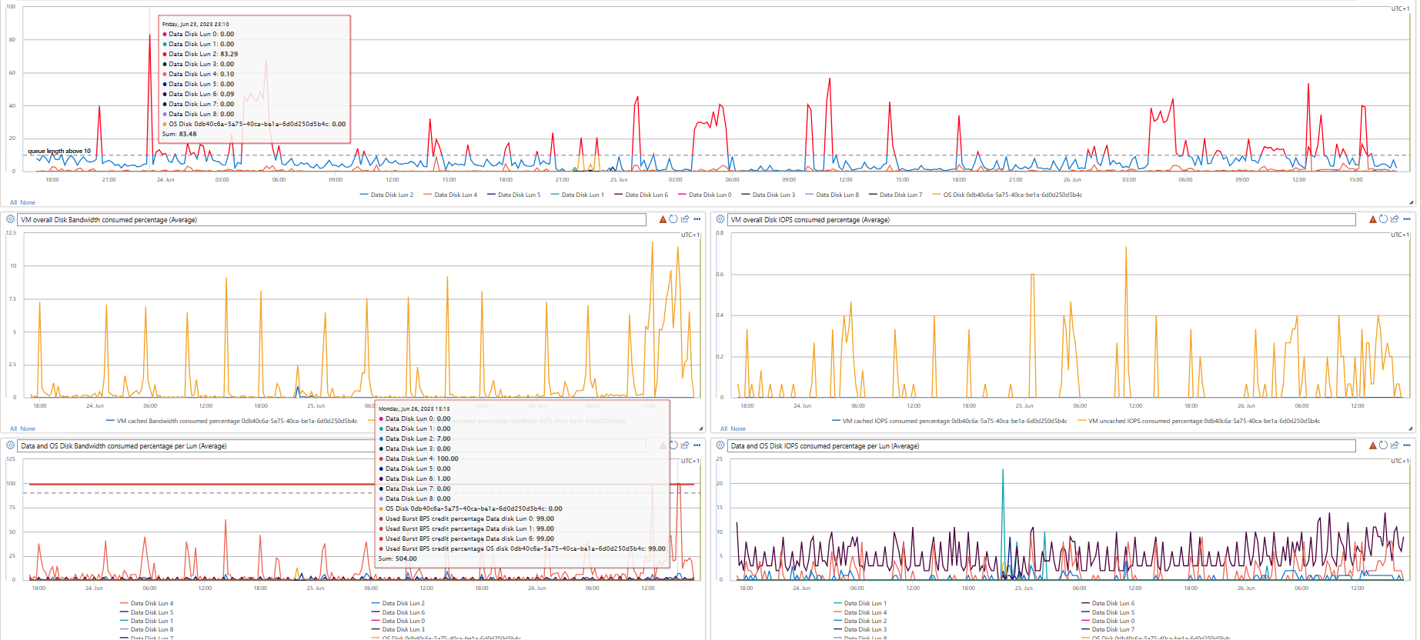
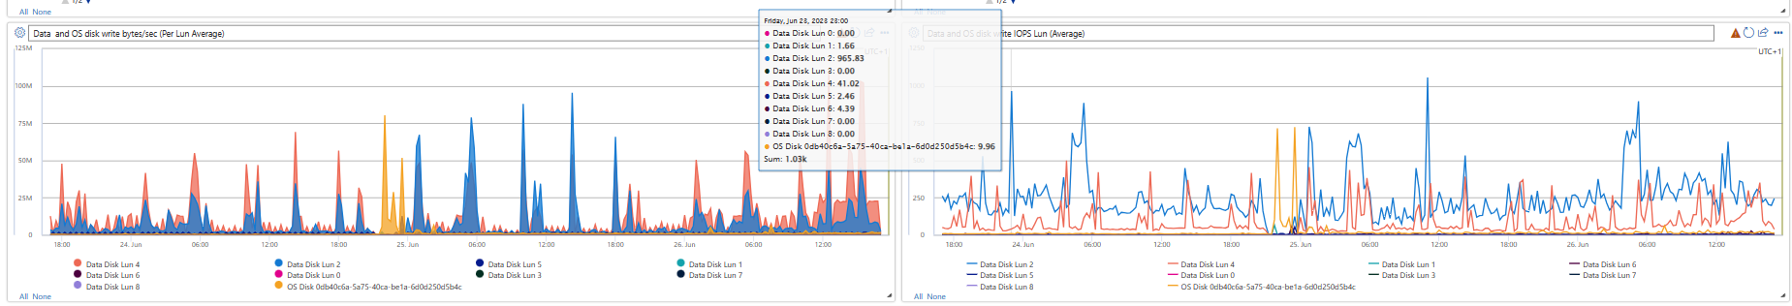
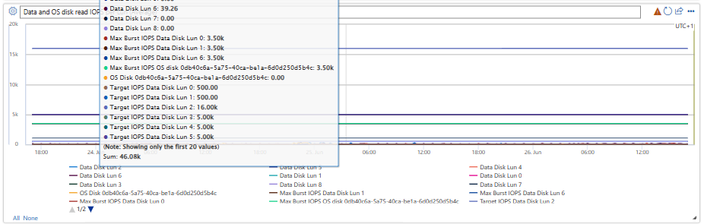
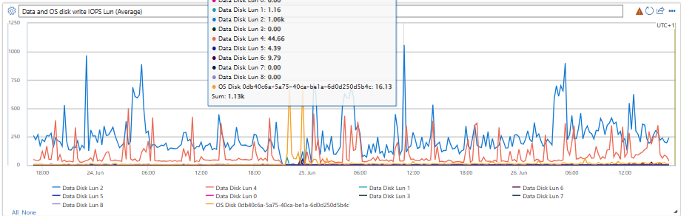
SR: 2306210030004689
https://portal.microsoftgeneva.com/s/F8132AE3?overrides=[{"query":"//dataSources","key":"account","replacement":"AzComputeShoeboxWEU"},{"query":"//*[id='ResourceId']","key":"value","replacement":"0db40c6a-5a75-40ca-be1a-6d0d250d5b4c"}]&globalStartTime=1687536888493&globalEndTime=1687796088502&pinGlobalTimeRange=true

Slide 5
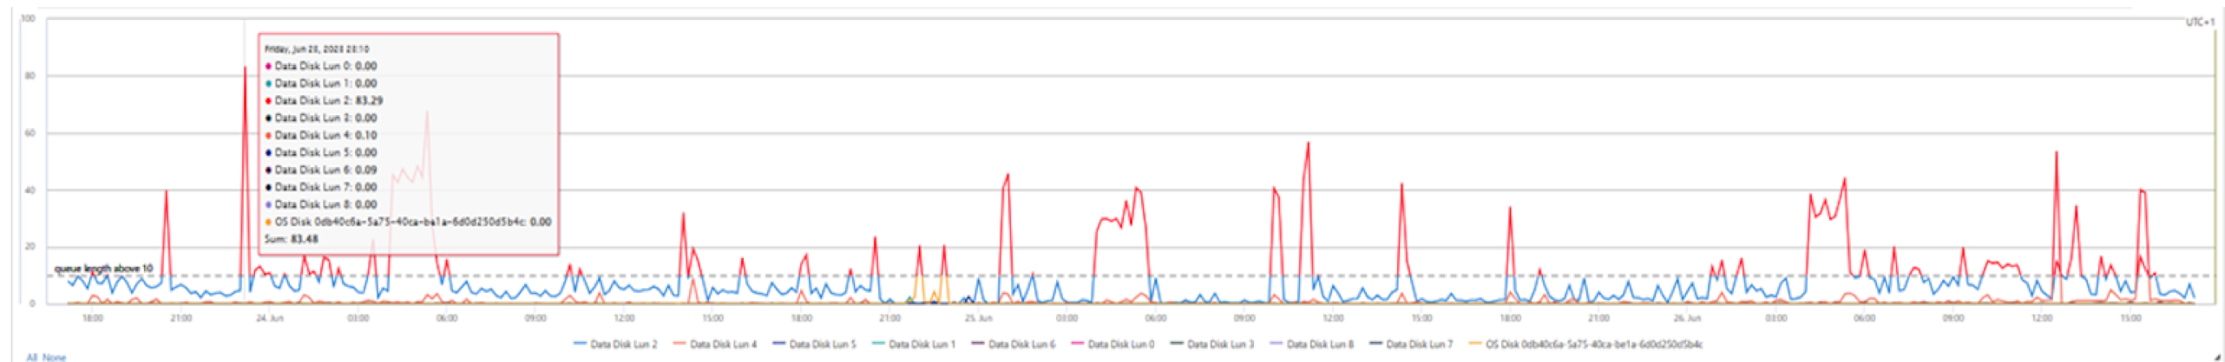
SR: 2306210030004689
https://portal.microsoftgeneva.com/s/F8132AE3?overrides=[{"query":"//dataSources","key":"account","replacement":"AzComputeShoeboxWEU"},{"query":"//*[id='ResourceId']","key":"value","replacement":"0db40c6a-5a75-40ca-be1a-6d0d250d5b4c"}]&globalStartTime=1687536888493&globalEndTime=1687796088502&pinGlobalTimeRange=true

Slide 6
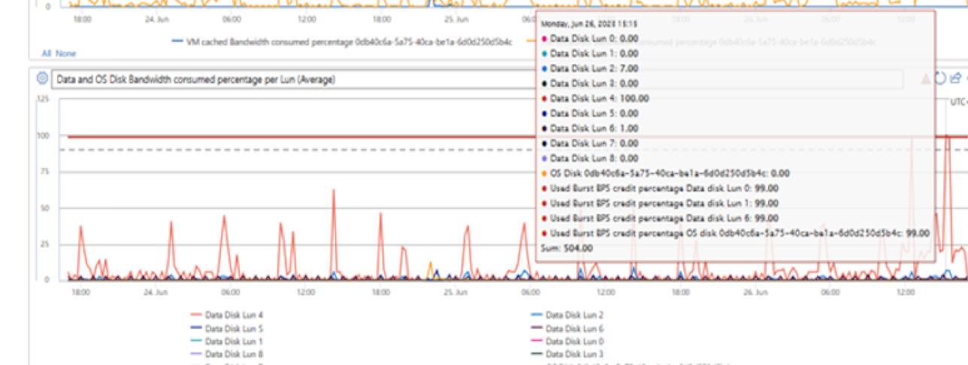
SR: 2306210030004689
https://portal.microsoftgeneva.com/s/F8132AE3?overrides=[{"query":"//dataSources","key":"account","replacement":"AzComputeShoeboxWEU"},{"query":"//*[id='ResourceId']","key":"value","replacement":"0db40c6a-5a75-40ca-be1a-6d0d250d5b4c"}]&globalStartTime=1687536888493&globalEndTime=1687796088502&pinGlobalTimeRange=true

Slide 7
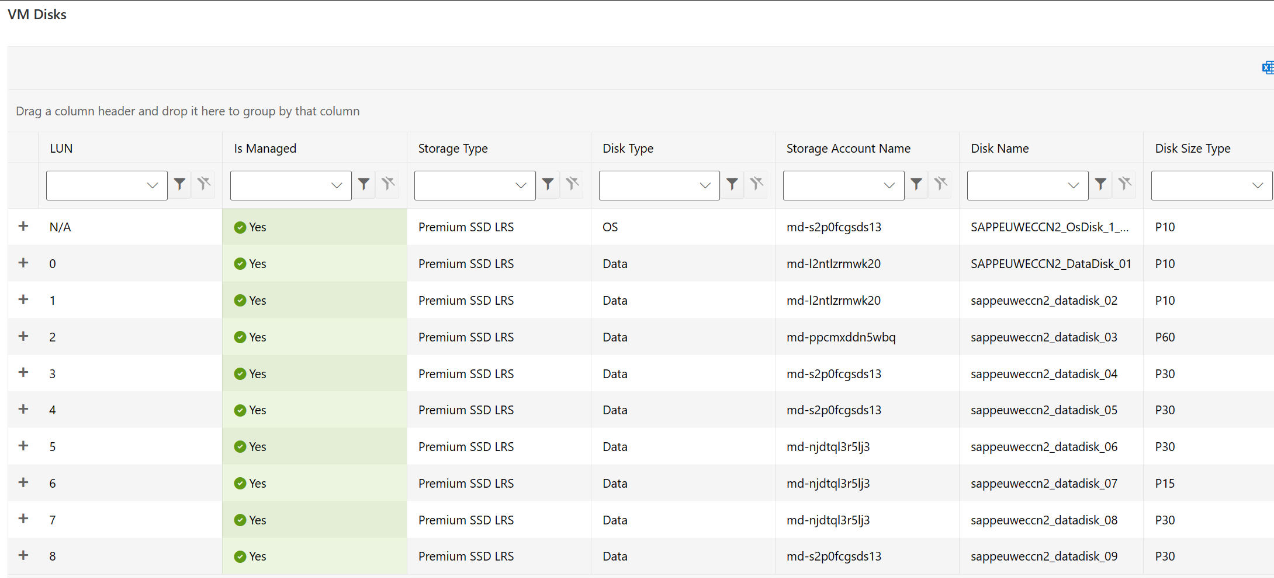
SR: 2306210030004689
Context: CX has requested some advisory questions and on an extra-mile purpose, it was done the following TSG.
Disk Type - OS | STG Acc Name | Disk Name | Disk Size | Disk IOPS
Data | md-l2ntlzrmwk20 | SAPPEUWECCN2_DataDisk_01 | P10 | 500
Data | md-l2ntlzrmwk20 | sappeuweccn2_datadisk_02 | P10 | 500
Data | md-ppcmxddn5wbq | sappeuweccn2_datadisk_03 | P60 | 16000
Data | md-s2p0fcgsds13 | sappeuweccn2_datadisk_04 | P30 | 5000
Data | md-s2p0fcgsds13 | sappeuweccn2_datadisk_05 | P30 | 5000
Data | md-njdtql3r5lj3 | sappeuweccn2_datadisk_06 | P30 | 5000
Data | md-njdtql3r5lj3 | sappeuweccn2_datadisk_07 | P15 | 1100
Data | md-njdtql3r5lj3 | sappeuweccn2_datadisk_08 | P30 | 5000
Data | md-s2p0fcgsds13 | sappeuweccn2_datadisk_09 | P30 | 5000
 |  |  | Total: | 43100

Slide 8
SR: 2306210030004689
Links
Edv4 and Edsv4-series - Azure Virtual Machines | Microsoft Learn
Select a disk type for Azure IaaS VMs - managed disks - Azure Virtual Machines | Microsoft Learn (P60)
Certified and Supported SAP HANA® Hardware DirectoryEdv5 and Edsv5-series - Azure Virtual Machines | Microsoft Learn
Size | vCPU | Memory: GiB | Temp storage (SSD) GiB | Max data disks | Max temp storage throughput: IOPS/MBps* | Max uncached disk throughput: IOPS/MBps | Max burst uncached disk throughput: IOPS/MBps1 | Max NICs | Max network bandwidth (Mbps)
Standard_E2ds_v44 | 2 | 16 | 75 | 4 | 9000/125 | 3200/48 | 4000/200 | 2 | 5000
Standard_E4ds_v4 | 4 | 32 | 150 | 8 | 19000/250 | 6400/96 | 8000/200 | 2 | 10000
Standard_E8ds_v4 | 8 | 64 | 300 | 16 | 38000/500 | 12800/192 | 16000/400 | 4 | 12500
Standard_E16ds_v4 | 16 | 128 | 600 | 32 | 75000/1000 | 25600/384 | 32000/800 | 8 | 12500
Standard_E20ds_v4 | 20 | 160 | 750 | 32 | 94000/1250 | 32000/480 | 40000/1000 | 8 | 16000
Standard_E32ds_v4 | 32 | 256 | 1200 | 32 | 150000/2000 | 51200/768 | 64000/1600 | 8 | 16000
Standard_E48ds_v4 | 48 | 384 | 1800 | 32 | 225000/3000 | 76800/1152 | 80000/2000 | 8 | 24000
Standard_E64ds_v4 2 | 64 | 504 | 2400 | 32 | 300000/4000 | 80000/1200 | 80000/2000 | 8 | 30000
Standard_E80ids_v4 3,5 | 80 | 504 | 2400 | 64 | 375000/4000 | 80000/1200 | 80000/2000 | 8 | 30000

Slide 9
SR: 2306210030004689
Links
Edv5 and Edsv5-series - Azure Virtual Machines | Microsoft Learn
Certified and Supported SAP HANA® Hardware DirectoryEdv5 and Edsv5-series - Azure Virtual Machines | Microsoft Learn
Size | vCPU | Memory: GiB | Temp storage (SSD) GiB | Max data disks | Max temp storage throughput: IOPS/MBps* | Max uncached disk throughput: IOPS/MBps | Max burst uncached disk throughput: IOPS/MBps | Max NICs | Max network bandwidth (Mbps)
Standard_E2ds_v5 | 2 | 16 | 75 | 4 | 9000/125 | 3750/85 | 10000/1200 | 2 | 12500
Standard_E4ds_v5 | 4 | 32 | 150 | 8 | 19000/250 | 6400/145 | 20000/1200 | 2 | 12500
Standard_E8ds_v5 | 8 | 64 | 300 | 16 | 38000/500 | 12800/290 | 20000/1200 | 4 | 12500
Standard_E16ds_v5 | 16 | 128 | 600 | 32 | 75000/1000 | 25600/600 | 40000/1200 | 8 | 12500
Standard_E20ds_v5 | 20 | 160 | 750 | 32 | 94000/1250 | 32000/750 | 64000/1600 | 8 | 12500
Standard_E32ds_v5 | 32 | 256 | 1200 | 32 | 150000/2000 | 51200/865 | 80000/2000 | 8 | 16000
Standard_E48ds_v5 | 48 | 384 | 1800 | 32 | 225000/3000 | 76800/1315 | 80000/3000 | 8 | 24000
Standard_E64ds_v5 | 64 | 512 | 2400 | 32 | 375000/4000 | 80000/1735 | 80000/3000 | 8 | 30000
Standard_E96ds_v5 | 96 | 672 | 3600 | 32 | 450000/4000 | 80000/2600 | 80000/4000 | 8 | 35000
Standard_E104ids_v52,3,4 | 104 | 672 | 3800 | 64 | 450000/4000 | 120000/4000 | 120000/4000 | 8 | 100000

Slide 10
SR: 2306210030004689
KQ – Used to detect sum of VM Disk IOPS > VM Limit – future ASC Warning Detector
// Get VM Details with shoeboxMdmAccountName cluster('azurecm').database('AzureCM').LogContainerSnapshot
| where PreciseTimeStamp > datetime(2023-07-10 00:00)
| where PreciseTimeStamp < datetime(2023-07-11 00:00)
| where subscriptionId == ‘XXXXX-XXXXX-XXXXX-XXXXX'
| where roleInstanceName has tolower(‘Instance_NAME')
| join kind=leftouter (
cluster('azurecm').database('AzureCM').LogClusterSnapshot
| where PreciseTimeStamp >= ago(2d)
| distinct shoeboxMdmAccountName, RegionFriendlyName, Tenant
) on $left.Tenant == $right.Tenant
| summarize by Region , containerType , RegionFriendlyName, subscriptionId, containerId, nodeId, tenantName, Tenant, roleInstanceName, virtualMachineUniqueId , shoeboxMdmAccountName, diskConfiguration
// Get VM Specs
let myContainerId = "12ddfa6a-e182-4c0d-85d8-516a9e1e65ed";
let myTenant = toscalar(cluster('azcore.centralus.kusto.windows.net').database('AzureCP').MycroftContainerSnapshot_Latest | where //PreciseTimeStamp between (startTime .. endTime) and
ContainerId == myContainerId | project PolicyName);
cluster('azcrp').database('crp_config').VMSizes | where FabricName == myTenant | project ExternalName, FabricName , vCPUs, MemoryMB, HyperVGenerations , UncachedDiskIOPS;

Slide 11
SR: 2306210030004689
// Get VM - Managed Disk Detail
let containerId = "ad4f7414-fda4-4043-9a7a-dbf68923e4a4";
let nodeId = "b0a443fb-2fb9-52f0-1f00-2481b52c894f";
let cluster = "AMS11PrdApp06";
let startTime = datetime("2023-06-18T00:05:10.000Z");
let endTime = datetime("2023-06-21T20:05:10.000Z");
let ClusterInfo = cluster("moseisley.kusto.windows.net").database("AzureCM").LogClusterSnapshot
| where PreciseTimeStamp between ((startTime - 2h) .. (endTime + 1h)) and Tenant == cluster
| distinct Tenant, AvailabilityZone;
let mainQuery = cluster("azcore.centralus.kusto.windows.net").database("Fa").OsXIOSurfaceCounterTable
| where PreciseTimeStamp between (startTime .. endTime) and NodeId == nodeId and Cluster == cluster
| extend ContainerId = tostring(split(split(SurfaceName, "_")[0], "~")[0])
| where ContainerId == containerId
| union (cluster("azcore.centralus.kusto.windows.net").database("Fa").OsUltraSSDCounterTable | where PreciseTimeStamp between (startTime .. endTime) and NodeId == nodeId and Cluster == cluster and ContainerId contains containerId)
| parse ArmId with * "/disks/" DiskName
//| parse BlobPath with NewBlobPath "?" *
| parse BlobPath with * "/" NewBlobPath "?" *
| extend BlobPath = case(isnotempty(NewBlobPath), NewBlobPath, BlobPath)
| extend StorageAccount = tostring(split(BlobPath, "/")[0])
| extend SurfaceName = case(isempty(SurfaceName), SurfaceGUID, SurfaceName)
| extend DiskSkuType = case(IsXIOdisk == 1, "Premium SSD",
BlobPath contains "md-ssd-", "Standard SSD",
IsXIOdisk == 0 and BlobPath !contains "md-ssd-" and Type == 0, "Standard HDD",
DiskSkuType == 0, "UltraSSD",
DiskSkuType == 1, "Premium SSD V2","")
| distinct CachePolicy, SurfaceName, BlobPath, ContainerId, StorageAccount, EncryptionFlags, Type, StorageTenant, SDFTenant, Cluster, DiskType, SlotId, DiskName, DiskSkuType
| extend StorageTenant = case(isempty(StorageTenant), tolower(tostring(split(SDFTenant, "-")[1])), StorageTenant)
| join kind = leftouter (
cluster("azcore.centralus.kusto.windows.net").database("Fa").OsConfigTable
| where PreciseTimeStamp between ((startTime - 6h) .. (endTime + 6h))
and NodeId == nodeId and Component == "blobprop" and Cluster == cluster
| extend BlobProperties = parse_json(ConfigValue)
| extend
DiskAccessTier = tostring(BlobProperties.blobproperties['x-ms-access-tier']),
DiskIOPSLimit = todecimal(BlobProperties.blobproperties['x-ms-blob-iops-limit']),
DiskBurstLimit = tostring(split(BlobProperties.blobproperties["x-ms-blob-burst-limits"],";")[0]),
//tostring(split(BlobPath, "/")[0])
DiskThruput_MBps = BlobProperties.blobproperties["x-ms-blob-throughput-limit"],
BurstThruput_MBps = BlobProperties.blobproperties["x-ms-blob-burst-throughput-limit"],
EnhancedConnectionVersion = BlobProperties.blobproperties["x-ms-enhancedconnectionversion"],
StorageTenant = tostring(BlobProperties.storagecluster)
| extend BlobProperties = BlobProperties.blobproperties
| summarize hint.strategy=shuffle arg_max(PreciseTimeStamp, *) by ConfigName
| project BlobPath = ConfigName, DiskAccessTier, DiskIOPSLimit, DiskBurstLimit, DiskThruput_MBps, BurstThruput_MBps, EnhancedConnectionVersion, BlobProperties, StorageTenant
| parse BlobPath with * "/" BlobPath
) on BlobPath
| extend StorageTenant = case(isnotempty(StorageTenant), StorageTenant, StorageTenant1)
| extend EnhancedConnectionVersion = case(isempty(BlobProperties), "Unknown", EnhancedConnectionVersion)
| project-away BlobPath1
// Stitch Compute Cluster Properties for Availability Zone
| join kind=leftouter (
ClusterInfo
) on $left.Cluster == $right.Tenant
| extend StorageCluster = substring(tolower(StorageTenant), 0, strlen(StorageTenant) - 1)
| join kind=leftouter (
ClusterInfo | project Tenant = tolower(Tenant), StorageClusterAvailabilityZone = AvailabilityZone
) on $left.StorageCluster == $right.Tenant
//
// Stitch T2 Colocation
//
| extend compute_cluster = tolower(Cluster)
| join kind=leftouter (
cluster("azdhrdma.centralus.kusto.windows.net").database("azdhrdma").AppStpUnderSameT2Mapping()
| where compute_cluster contains cluster
| extend compute_cluster = tolower(compute_cluster)
) on compute_cluster
| extend DiskType = case(DiskType == 1, "OS Disk", DiskType == 2, "Temp Disk", DiskType == 3 or BlobPath contains "md-dd", "Data Disk", "")
| where DiskType != "Temp Disk"
| extend DiskType = case(Type == 4, strcat(DiskType, " (WriteAccelerator)"), DiskType)
| extend AZColocation = case(CachePolicy == 5, "", AvailabilityZone == StorageClusterAvailabilityZone, "Yes", isnotempty(AvailabilityZone) or isnotempty(StorageClusterAvailabilityZone), "No", "Unknown")
| extend T2Colocation = case(CachePolicy == 5, "", xio_clusters contains StorageCluster, "Yes", "No")
| extend LUN = case(DiskType == "OS Disk" or DiskType == "Temp Disk", "NA", tostring(SlotId))
| project Region,ContainerId, CachePolicy, DiskType, DiskSkuType, LUN, DiskName, DiskAccessTier, DiskIOPSLimit, DiskBurstLimit,DiskThruput_MBps, BurstThruput_MBps, BlobPath, StorageAccount, StorageTenant, AZColocation, T2Colocation
| extend CachePolicy = case(CachePolicy == 0, "None", CachePolicy == 1, "ReadOnly", CachePolicy == 2, "ReadWrite", CachePolicy == 5, "LocalDisk", BlobPath contains "md-dd", "None", tostring(CachePolicy));
let sumQuery = mainQuery
| summarize DiskIOPSLimit = sum((DiskIOPSLimit));
union mainQuery, sumQuery
| sort by LUN asc
| sort by DiskType desc;

Slide 12
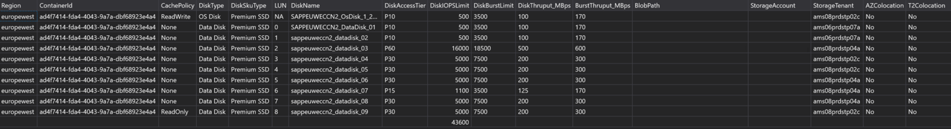
SR: 2306210030004689
VM Disks IOPS Detail/SUM

Slide 13
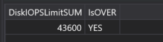
SR: 2306210030004689
KQ – Used to detect sum of VM Disk IOPS > VM Limit – future ASC Warning Detector – SE and CX facing
// Get VM - Managed Disk SUM vs VM IOPS
let startTime = datetime("2023-07-31T00:05:10.000Z");
let endTime = datetime("2023-08-01T00:05:10.000Z");
let myContainerId = "12ddfa6a-e182-4c0d-85d8-516a9e1e65ed";
let myNodeId = "5f098cf5-9069-cae3-790d-d478ba69e737";
let myTenant = toscalar(cluster('azcore.centralus.kusto.windows.net').database('AzureCP').MycroftContainerSnapshot_Latest | where //PreciseTimeStamp between (startTime .. endTime) and
ContainerId == myContainerId | project ClusterName , PolicyName);
let vmIOPSLimit = toscalar(cluster('azcrp').database('crp_config').VMSizes | where FabricName == myTenant | project UncachedDiskIOPS);
macro-expand isfuzzy=true AzCoreKusto as data (
data.database("Fa").OsXIOSurfaceCounterTable
| where PreciseTimeStamp between (startTime .. endTime) and Cluster == myTenant and NodeId == myNodeId
| extend ContainerId = tostring(split(split(SurfaceName, "_")[0], "~")[0]) | where ContainerId == myContainerId
| union (cluster("azcore.centralus.kusto.windows.net").database("Fa").OsUltraSSDCounterTable
| where PreciseTimeStamp between (startTime .. endTime) and Cluster == myTenant and NodeId == myNodeId and ContainerId == myContainerId)
| parse BlobPath with NewBlobPath "?" * | parse BlobPath with * "/" NewBlobPath "?" *
| extend BlobPath = case(isnotempty(NewBlobPath), NewBlobPath, BlobPath)
| distinct CachePolicy, SurfaceName, BlobPath, ContainerId, EncryptionFlags, Type, StorageTenant, SDFTenant, Cluster, DiskType, SlotId, DiskSkuType
| join kind = leftouter (
data.database("Fa").OsConfigTable
| where Cluster == myTenant and NodeId == myNodeId and Component == "blobprop" and PreciseTimeStamp between (startTime .. endTime)
| extend BlobProperties = parse_json(ConfigValue)
| extend DiskIOPSLimit = todecimal(BlobProperties.blobproperties['x-ms-blob-iops-limit'])
| summarize hint.strategy=shuffle arg_max(PreciseTimeStamp, *) by ConfigName
| project BlobPath = ConfigName, DiskIOPSLimit
| parse BlobPath with * "/" BlobPath
) on BlobPath)
| summarize DiskIOPSLimitSUM = sum(DiskIOPSLimit)
| extend IsOVER = iif ( DiskIOPSLimitSUM > vmIOPSLimit , "YES" , "NO")
//| where IsOVER == "YES";

Slide 14
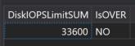
SR: 2306210030004689
KQ – Used to detect sum of VM Disk IOPS > VM Limit – future ASC Warning Detector – SE and CX facing
// Get VM - Managed Disk SUM vs VM IOPS
let startTime = datetime("2023-08-01T00:05:10.000Z");
let endTime = datetime("2023-08-02T00:05:10.000Z");
let myContainerId = "12ddfa6a-e182-4c0d-85d8-516a9e1e65ed";
let myNodeId = "5f098cf5-9069-cae3-790d-d478ba69e737";
let myTenant = toscalar(cluster('azcore.centralus.kusto.windows.net').database('AzureCP').MycroftContainerSnapshot_Latest | where //PreciseTimeStamp between (startTime .. endTime) and
ContainerId == myContainerId | project ClusterName , PolicyName);
let vmIOPSLimit = toscalar(cluster('azcrp').database('crp_config').VMSizes | where FabricName == myTenant | project UncachedDiskIOPS);
macro-expand isfuzzy=true AzCoreKusto as data (
data.database("Fa").OsXIOSurfaceCounterTable
| where PreciseTimeStamp between (startTime .. endTime) and Cluster == myTenant and NodeId == myNodeId
| extend ContainerId = tostring(split(split(SurfaceName, "_")[0], "~")[0]) | where ContainerId == myContainerId
| union (cluster("azcore.centralus.kusto.windows.net").database("Fa").OsUltraSSDCounterTable
| where PreciseTimeStamp between (startTime .. endTime) and Cluster == myTenant and NodeId == myNodeId and ContainerId == myContainerId)
| parse BlobPath with NewBlobPath "?" * | parse BlobPath with * "/" NewBlobPath "?" *
| extend BlobPath = case(isnotempty(NewBlobPath), NewBlobPath, BlobPath)
| distinct CachePolicy, SurfaceName, BlobPath, ContainerId, EncryptionFlags, Type, StorageTenant, SDFTenant, Cluster, DiskType, SlotId, DiskSkuType
| join kind = leftouter (
data.database("Fa").OsConfigTable
| where Cluster == myTenant and NodeId == myNodeId and Component == "blobprop" and PreciseTimeStamp between (startTime .. endTime)
| extend BlobProperties = parse_json(ConfigValue)
| extend DiskIOPSLimit = todecimal(BlobProperties.blobproperties['x-ms-blob-iops-limit'])
| summarize hint.strategy=shuffle arg_max(PreciseTimeStamp, *) by ConfigName
| project BlobPath = ConfigName, DiskIOPSLimit
| parse BlobPath with * "/" BlobPath
) on BlobPath)
| summarize DiskIOPSLimitSUM = sum(DiskIOPSLimit)
| extend IsOVER = iif ( DiskIOPSLimitSUM > vmIOPSLimit , "YES" , "NO")
//| where IsOVER == "YES";

Slide 15
SAP Enablement Team brownbag sessions
Tiago Simões

